Slide 1








Slide 2







Prototype
To understand the idea of developing the
function, let’s imagine the following analogy.
Someone is going to open a shop , first thing he will do is to make a banner announcing his shop. This banner is called a prototype.
Then, he will develop his shop and prepare all services that will be provided. This is called the implementation.
Implementation
Last thing, customers will call the shop and ask for a service, he will answer them and provide them with the required service. This is called the call.
Call

Slide 3



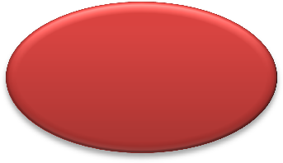




Caller
A function is a block of code that will be defined one time and can be executed many times.
To execute the function you will need to call it. The function provides you with the advantage that it is defined one time and can be executed many times so it takes the same size in the memory whatever how many times it would be called.
Arguments
When you call a function, you can send to it some
inputs and it could return back an output.
One example of the functions is the printf function that takes a string as an input argument and print it on the screen.
return
Any C project composed of one function or more, the most popular function is the main function which the first function to be called (The entry point)
Function

Slide 4




Function composed of two parts
1- The prototype
Used to declare the function (The banner)
Input Arguments
return_type Function_Name (Input_Type Input_Name , …… );
The function body (The implementation )
Used to define the function behavior
return_type Function_Name (Input_Type Input_Name , ……)
{
Function statements
}
Function call
Used to execute the function
Output = Function_Name(Inputs)

Slide 5



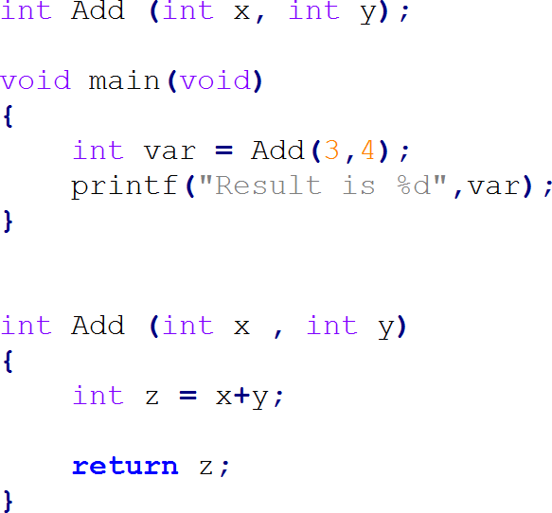
1- Prototype of function named Add and takes 2 arguments one called x of type int and the other one called y of type int too. The function will return an int value
3- Function call, the main function calls the Add function and send to it the two arguments 3 and 4, then it will receive the result in the variable var.
2- Function implementation, it will add x and y and save the value in the variable z. Then it will return the value of z.

Slide 6







Expected Output
Write C code that will ask the user to enter 2 numbers, then the main function will call a function named Get_Max that takes the 2 values entered by the user then return the maximum of them.
The main function then will print the returned value

Slide 7



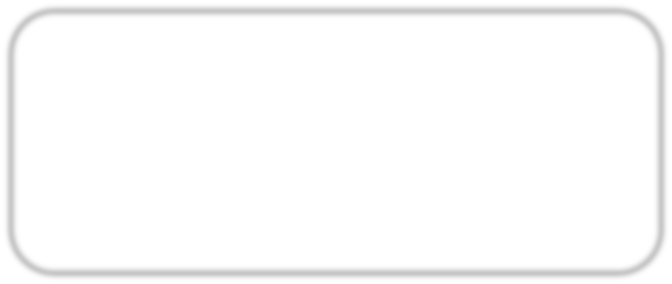
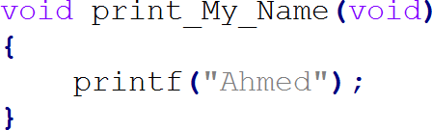

The void keyword is used to any function to give the meaning of No thing.
For example if we need to define a function that takes no arguments, we
would write between its ( ) the keyword void.
If we need to define a function that doesn’t return any outputs, we will write instead of the return type the keyword void.
The function can neither takes input arguments nor return outputs.
Example for a function that
takes void and return void

Slide 8
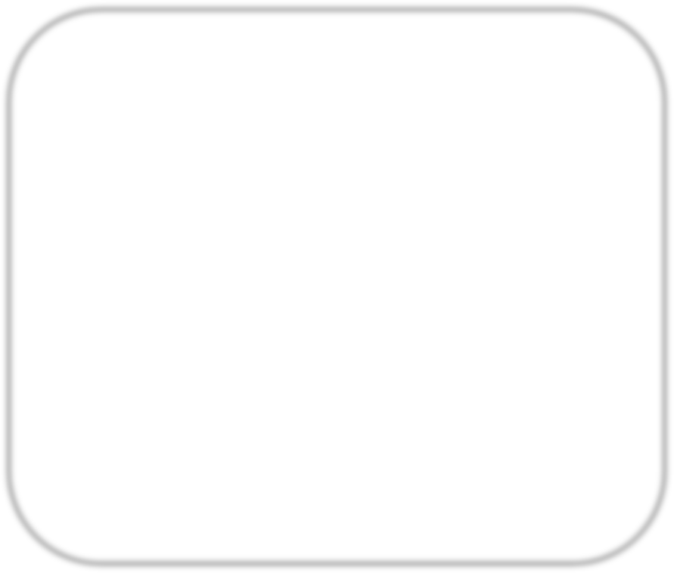
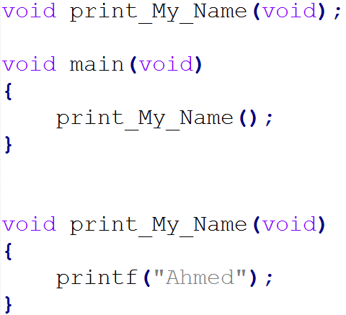
To Call a function that takes void, then write its and and empty ( )
To Call a function that returns void, then don’t receive its output in a variable
Call for a function that takes void and return void

Slide 9

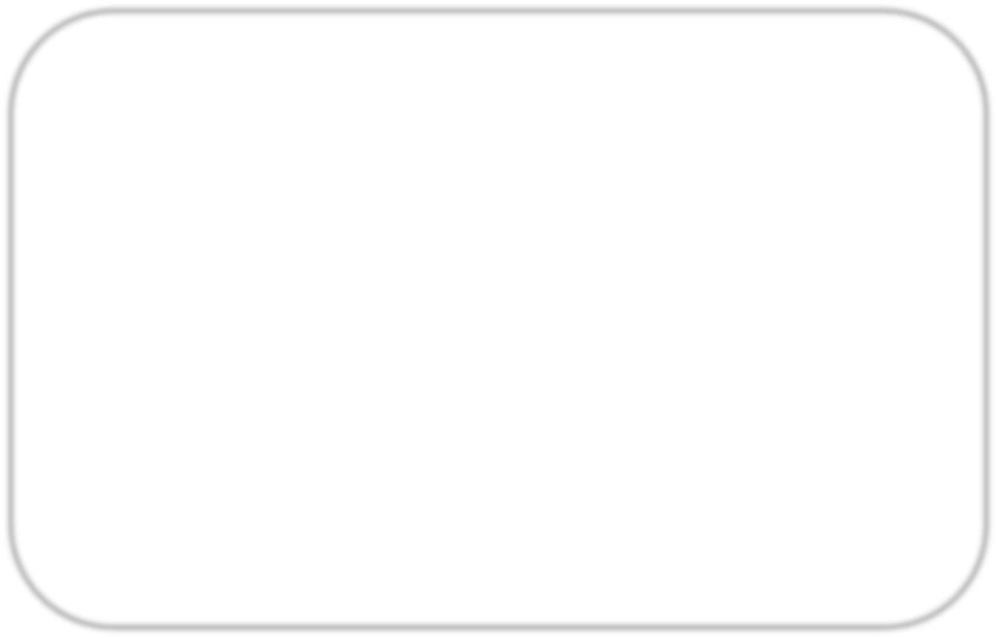
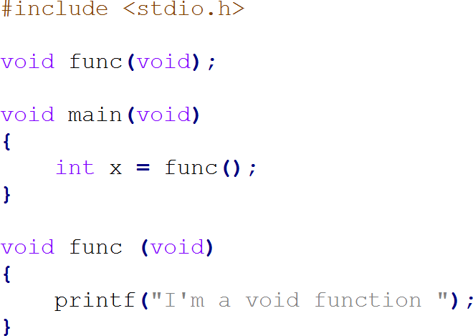
What will be the output of the following code … ?

Slide 10


What will be the output of the following code … ?
Compilation error, trying to receive a value from a function that returns void

Slide 11



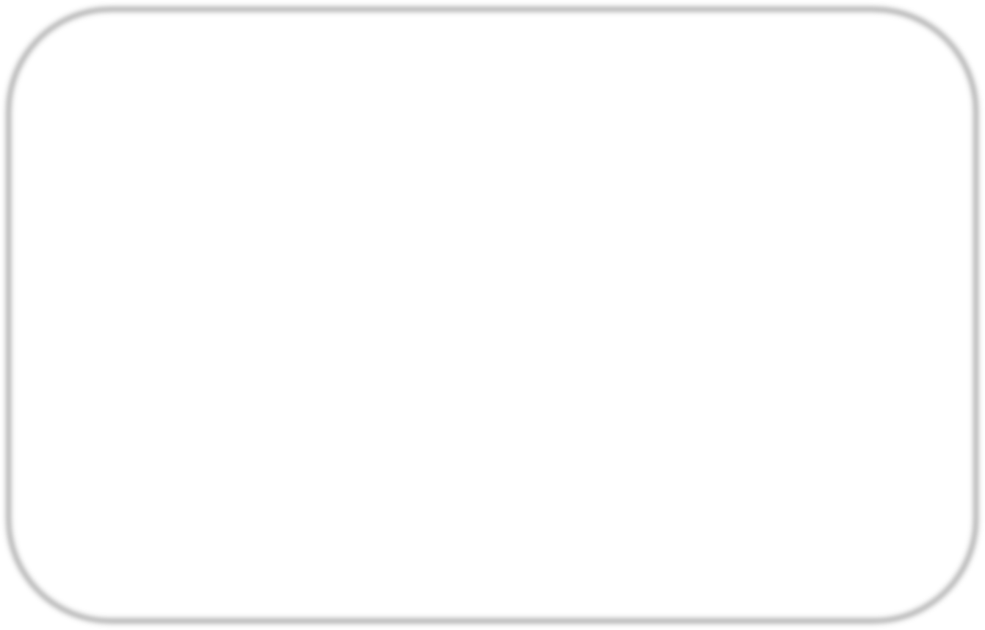
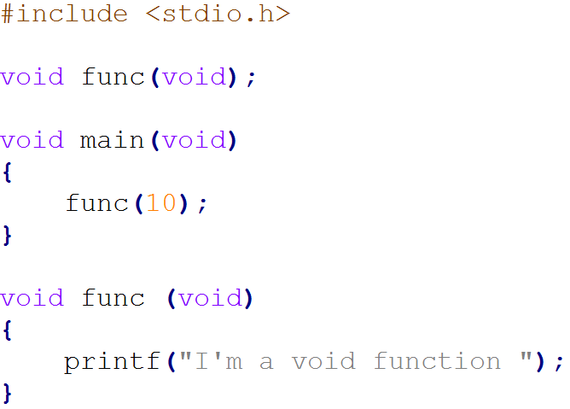
What will be the output of the following code … ?

Slide 12





What will be the output of the following code … ?
Compilation error, trying to send a value for function that takes void

Slide 13





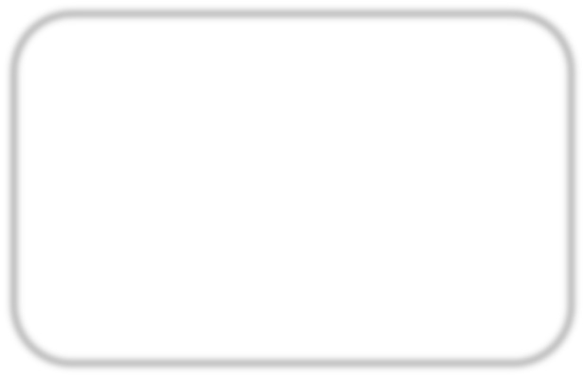
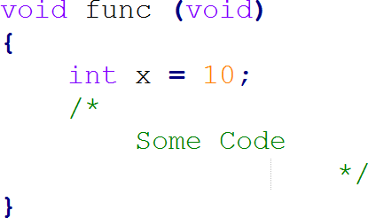

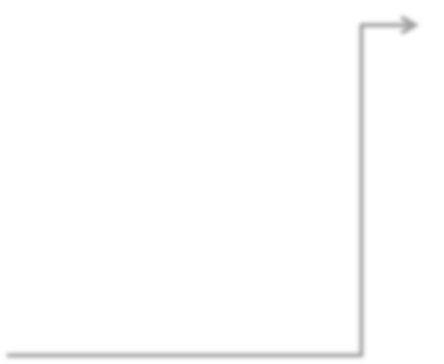
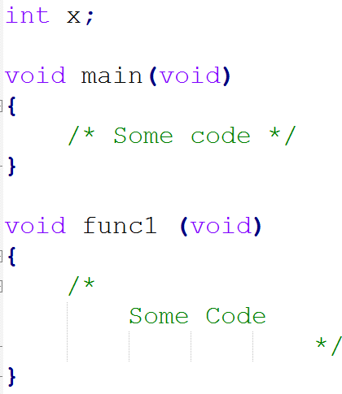
Local variable is the variable that it is defined inside any function, this variable can be accessed only on the function that defines it.
x is a local variable can be accessed only the function named func
Global variable is the variable that is defined outside any function, this variable can be accessed in any function in the code
x is a Global variable can be accessed in any function in the program

Slide 14


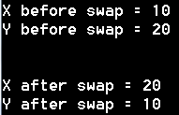
Expected Output
Write C code implement a function to swap 2 global variables.

Slide 15





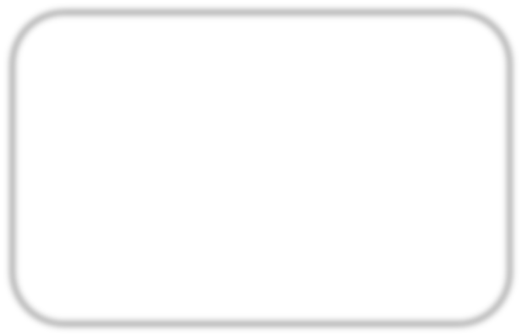
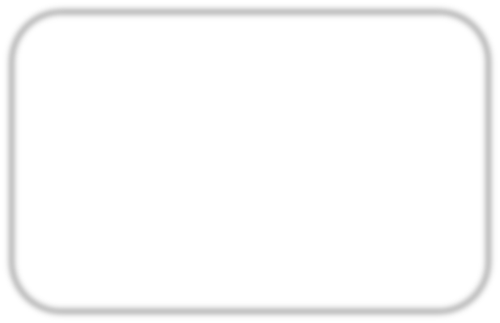
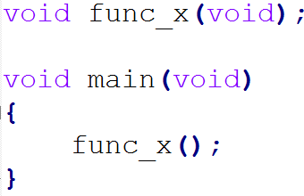
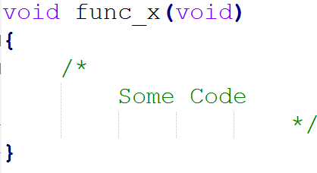
Sometimes it would be recommended to split your project into some C files for issue of modularity and organization. All the c files will compile together to generate one output file.
The general rule is, To use call function_x (that is defined in file_1) in file_2, file_2 must know the prototype of function_x
file_1.c file_2.c
To compile the two files on gcc together, just write them in the command as follows:

Slide 16

Write C code that contains two functions; PrintMyName and main. PrintMyName is defined in file2.c and its role is to print your name. main is define in file1.c and its role is to call PrintMyName function

Slide 17




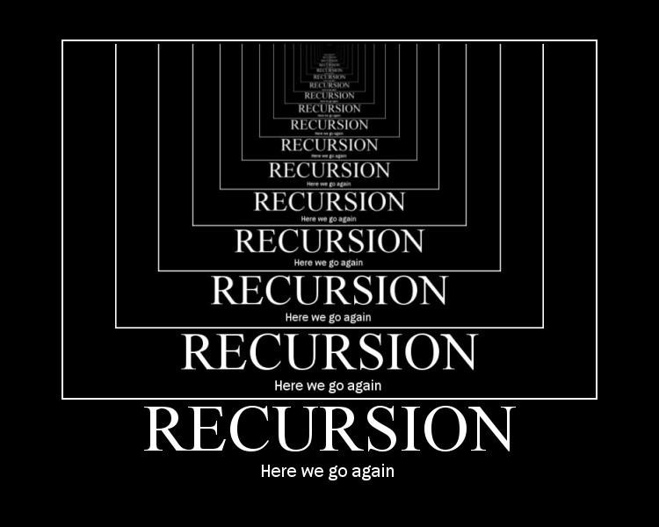
A function that calls itself is known as a recursive function. And, this technique is
known as recursion.
Recursion in not recommended in Embedded Systems development because it use more memory and are generally slow.

Slide 18



Write C code that calculates the factorial of a number entered by the user using recursive function

Slide 19
Any questions
… ?

Slide 20


Write a C program the implement 2 function:
Function to get the maximum of 4 values
Function to get the minimum of 4 values
The program will ask the user first to enter the 4 values, then print the maximum number and minimum number of them.

Slide 21



Write a C program to act as simple calculator, first it will ask the user to enter the operation ID, depending on the operation, the program will ask the user either to enter 1 operand or 2 operands and the program will execute the operation and print the result. Each operation should be implemented in a stand a long function.
ID | Operation | Number of Operands
1 | Add | 2
2 | Subtract | 2
3 | Multiply | 2
4 | Divide | 2
5 | And | 2
6 | Or | 2
7 | Not | 1
8 | Xor | 2
9 | reminder | 2
10 | Increment | 1
11 | Decrement | 1

Slide 22
Thank you

